Slide 1
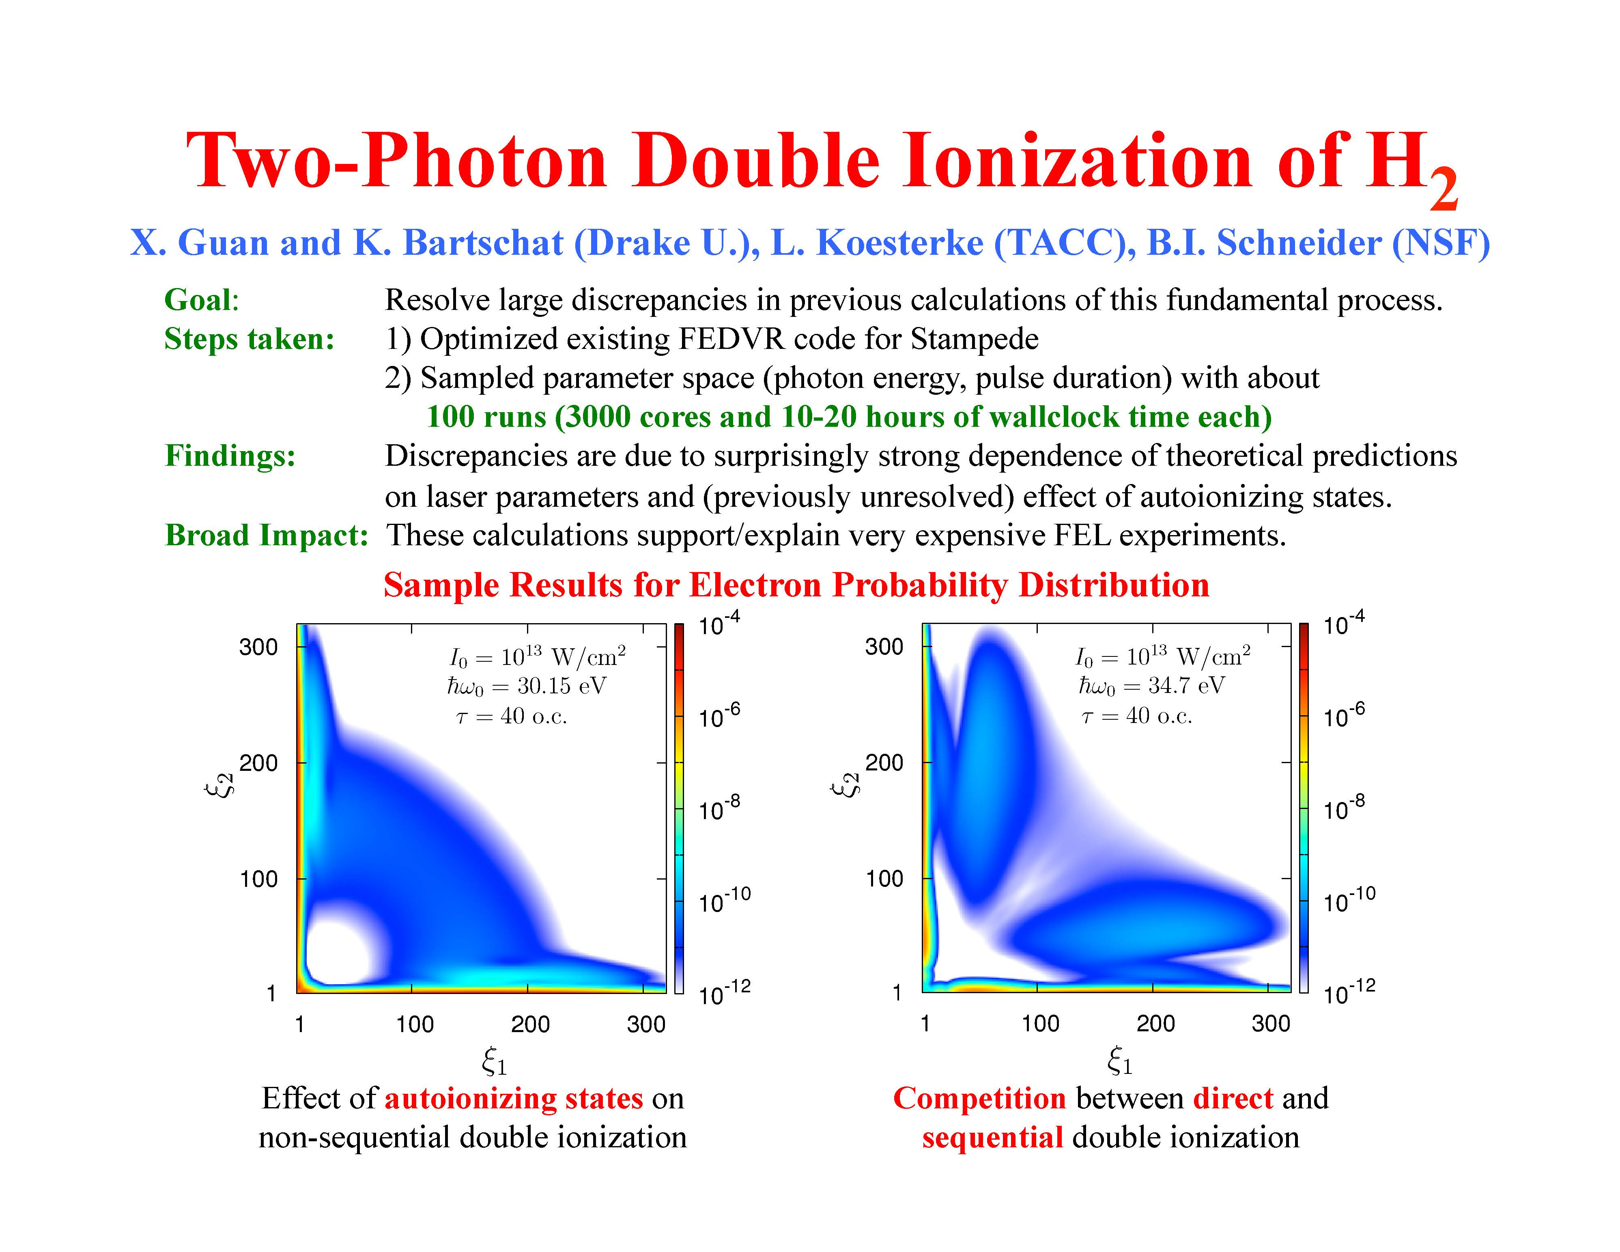
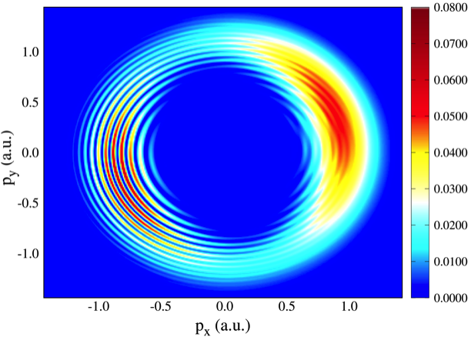
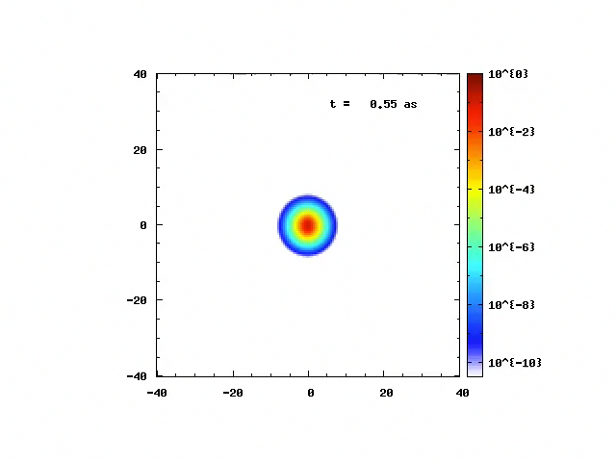
Ionization of Ar(3d) by electron Impact:
Experiment(a) and Theory(b)
Photoelectron Momentum Distribution for Ar
Ionization in Strong Electromagnetic Field
H⁺₂ Ionization in strong, ultrafast
electromagnetic field

Slide 2
AMPGateway
Two Photon Double Ionization of He at 70 eV for Short(a) to Long Pulses(3) – Note How Sequential Ionization Breaks Down

